Slide 1
Programming with RDD

Slide 2
Resilient Distributed Dataset
A Resilient Distributed Dataset (RDD) is the fundamental data structure of Apache Spark.
It is an immutable, distributed collection of objects that allows fault-tolerant parallel processing across a cluster.

Slide 3
Key Features
Immutable & Distributed:
Once created, RDDs cannot be modified, but transformations can generate new RDDs.
Data is distributed across multiple nodes in a Spark cluster.
Fault Tolerant (Resilient)
If a node fails, Spark automatically reconstructs lost data using lineage information (recomputing transformations).
Lazy Evaluation
Operations on RDDs are not executed immediately but recorded as a DAG (Directed Acyclic Graph).
Execution starts only when an action (like .collect() or .count()) is called.

Slide 4
Key Features
Partitioned for Parallelism
RDDs are divided into partitions, allowing parallel processing across a cluster.
Supports Two Types of Operations
Transformations: Create a new RDD from an existing one (e.g., map(), filter(), flatMap()).
Actions: Trigger execution and return results (e.g., count(), collect(), reduce()).

Slide 5
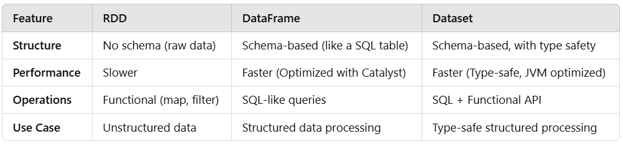
RDD vs. DataFrame vs. Dataset

Slide 6
Use of RDD
RDDs are useful for unstructured and semi-structured data processing, making them ideal for log analysis, real-time analytics, and custom computations.
For structured data, DataFrames are often a better choice due to built-in optimizations.

Slide 7
Use of RDD
A company collects web server logs daily, containing details about user visits. The logs are stored in HDFS, and the company wants to analyze the top 5 most visited web pages.
Solution Using RDD:
Load the log file from HDFS into an RDD
Extract the URL from each log entry
Count the occurrences of each URL
Sort the results and find the top 5 most visited URLs

Slide 8
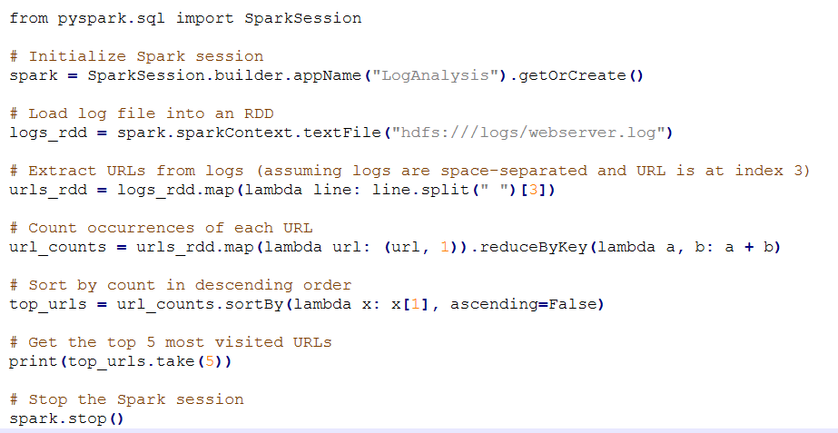
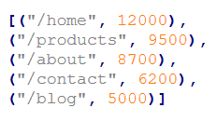
Code example using Pyspark
Output of Code

Slide 9
Key Concept: RDD’s
Write programs in terms of operations on distributed datasets
Resilient Distributed Datasets
Collections of objects spread across a cluster, stored in RAM or on Disk
Built through parallel transformations
Automatically rebuilt on failure
Operations
Transformations (e.g. map, filter, groupBy)
Actions (e.g. count, collect, save)
Notes:
RDD ➔ Colloquially referred to as RDDs
(e.g. caching in RAM)
Lazy operations to build RDDs from other RDDs
Return a result or write it to storage

Slide 10

Example: Log Mining
Load error messages from a log into memory, then interactively search for various patterns
Base RDD
Transformed RDD
Cache 1
lines = spark.textFile(“hdfs://...”)
errors = lines.filter(lambda s: s.startswith(“ERROR”))
messages = errors.map(lambda s: s.split(“\t”)[2])
messages.cache()
results
Worker
tasks
Block 1
Driver
Action
messages.filter(lambda s: “mysql” in s).count()
Cache 2
messages.filter(lambda s: “php” in s).count()
Worker
Cache 3
. . .
Full-text search of Wikipedia
60GB on 20 EC2 machine
0.5 sec vs. 20s for on-disk
Worker
Block 2
Block 3
Notes:
Add “variables” to the “functions” in functional programming

Slide 11
Scaling Down
Notes:
Gracefully

Slide 12
Fault Recovery
RDDs track lineage information that can be used to efficiently recompute lost data
msgs = textFile.filter(lambda s: s.startsWith(“ERROR”))
.map(lambda s: s.split(“\t”)[2])
HDFS File
Filtered RDD
Mapped RDD
filter (func = startsWith(…))
map (func = split(...))

Slide 13
Fault recovery explained
Lineage Tracking in RDDs:
RDDs maintain a record of transformations applied to them, called lineage.
This allows lost partitions of RDDs to be recomputed efficiently instead of replicating data.
Transformation Pipeline:
HDFS File: The raw dataset is read from HDFS.
Filtered RDD: A filter transformation is applied to keep only lines that start with "ERROR".
Mapped RDD: A map transformation extracts the third column from each filtered line.
Fault Tolerance Mechanism:
If a node fails, Spark recomputes lost partitions using the lineage information instead of reloading everything.

Slide 14
Features of RDD
The RDD data structure is based on principles and features to control and optimize the code.
Immutability:
It’s a crucial concept of functional programming that has the benefit of making parallelism easier. Whenever we want to change the state of an RDD, we create a new one with all transformations performed.

Slide 15
In-memory computation:
With Spark, we can work with data in RAM instead of disk. Because loading and processing performance increases when using RAM compared to disk.
Fault-Tolerant:
The system keeps working correctly even with eventual failure with this architecture.
what is necessary and hereafter optimized

Slide 16
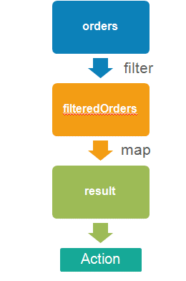
Partitioning:
RDDs data are distributed across nodes to perform better computation.
Lazy evaluation:
In addition to performance, Spark RDD is evaluated lazily to only process

Slide 17
What is Lazy Evaluation?
Lazy evaluation is a key concept in Apache Spark, where the transformations on data are not immediately executed, but rather their execution is delayed until an action is triggered.
In Spark, transformations are operations that convert an input RDD (Resilient Distributed Dataset) or DataFrame into a new RDD or DataFrame.
When transformations are called in Spark, they do not immediately compute their results. Instead, Spark builds up a logical execution plan called the DAG (Directed Acyclic Graph) that represents the sequence of transformations to be applied.
The DAG is an internal representation of the computation.

Slide 18
Transformation
Spark Transformation is a function that produces new RDD from the existing RDDs.
It takes RDD as input and produces one or more RDD as output.
Each time it creates new RDD when we apply any transformation.
Thus, the so input RDDs, cannot be changed since RDD are immutable in nature.

Slide 19
Types of Transformation
There are two types of transformations:
Narrow transformation
Transformations where each partition of the parent RDD is used by at most one partition of the child RDD.
No shuffling across partitions → Faster execution.
Data locality is preserved (processed within the same partition).
Examples are:
map() → Applies a function to each element independently.
filter() → Keeps only elements that satisfy a condition.
flatMap() → Similar to map(), but can return multiple values per input.

Slide 20
Wide transformation
Transformations where one partition of the parent RDD is used by multiple partitions of the child RDD.
Requires data shuffling → Slower execution.
Involves network communication, making it expensive.
Examples are:
groupByKey() → Groups data based on key (shuffles data across nodes).
reduceByKey() → Similar to groupByKey(), but performs aggregation before shuffling.
join() → Joins datasets based on key, requiring data movement.

Slide 21
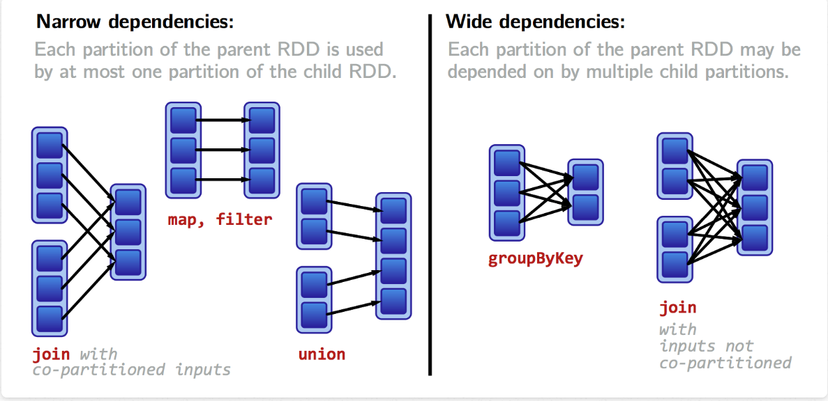

Slide 22
Real-Life Example: Narrow vs. Wide Transformation in RDDs
Imagine you are managing an e-commerce platform like Amazon and analyzing sales data.
The dataset has (Order ID, Product, Category, Price, Quantity, City).
Scenario for Narrow Transformation (Fast, No Shuffling):
Apply 10% discount to all products.
Since this task does not require data shuffling, it is a narrow transformation.
Each order is processed independently within its partition.
Each record is modified individually in its partition.
Use Case: Applying discounts, converting currency, modifying product names, etc.

Slide 23
Real-Life Example: Narrow vs. Wide Transformation in RDDs
Scenario for Wide Transformation (Slow, Requires Shuffling):
Calculate total sales revenue per city
This requires grouping orders by city.
Sales data is stored across multiple partitions → Spark must shuffle data to bring all sales from the same city together.
Shuffling happens because data is moved to aggregate sales per city.
Use Case: Summing up sales, counting orders per city, grouping customer reviews, etc.

Slide 24
Actions
Actions in Spark, trigger the execution of the entire DAG, and the computed results are returned to the driver program or written to an external storage system.
Transformations define the logic, but actions trigger execution.
Unlike transformations (which are lazily evaluated), actions force execution of the transformations applied on an RDD.

Slide 25
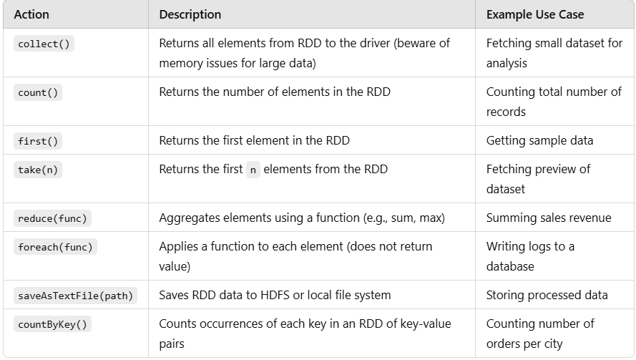
Common RDD Actions and Uses

Slide 26
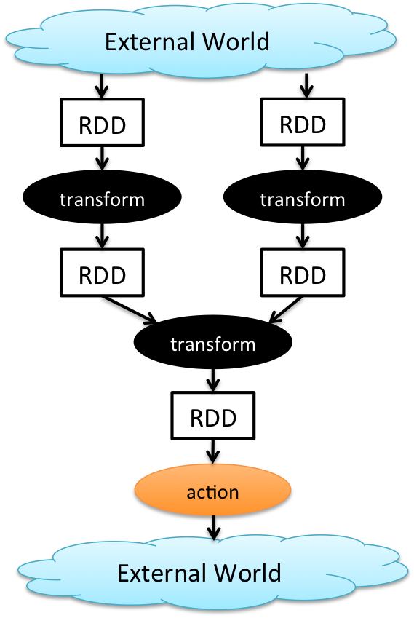
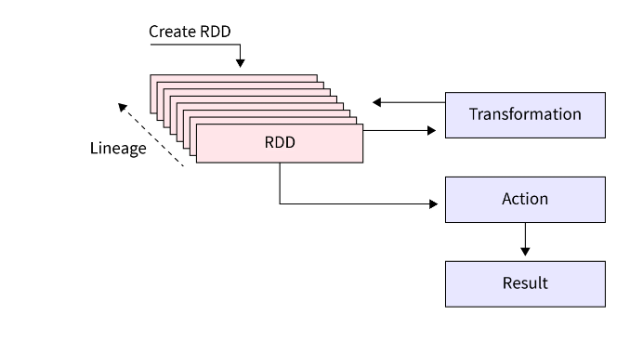
How Apache Spark's Transformations And Action works

Slide 27
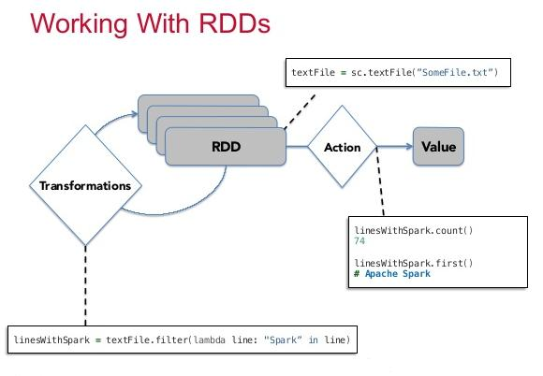

Slide 28
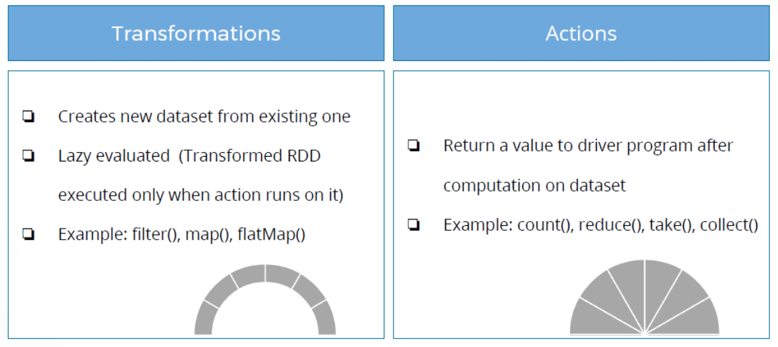
Transformation and Action in Spark

Slide 29
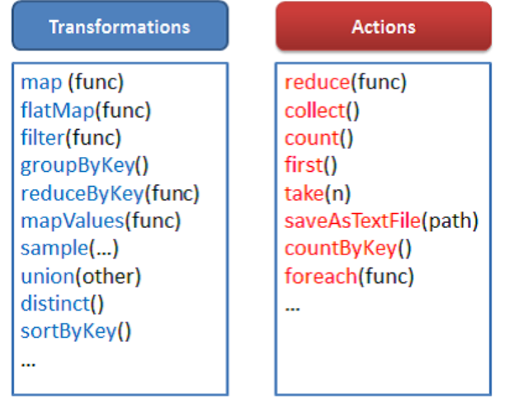
Transformation and Action in Spark

Slide 30
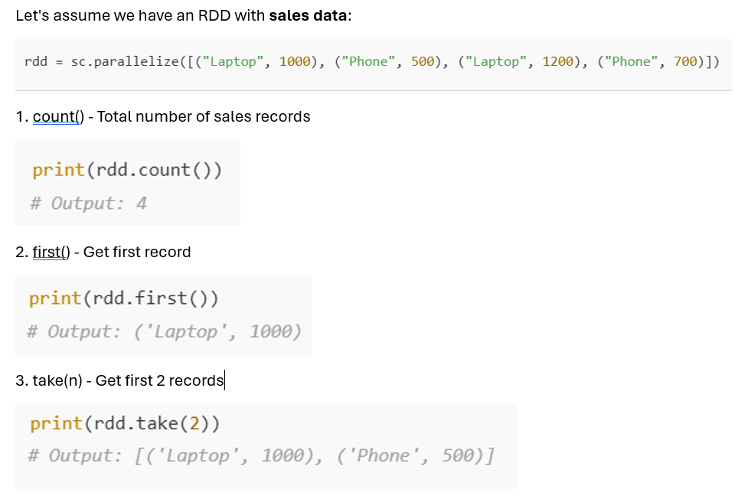
Actions in Spark RDD

Slide 31
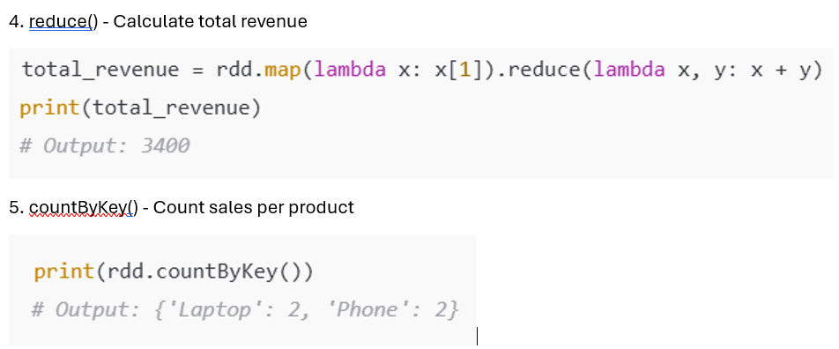
Actions in Spark RDD (cont.)

Slide 32
Programming with RDD’s

Slide 33
Spark Context
Main entry point to Spark functionality
Available in shell as variable sc
In standalone programs, you’d make your own (see later for details)

Slide 34
Creating RDDs
# Turn a Python collection into an RDD
sc.parallelize([1, 2, 3])
# Load text file from local FS, HDFS, or S3
sc.textFile(“file.txt”)
sc.textFile(“directory/*.txt”)
sc.textFile(“hdfs://namenode:9000/path/file”)
# Use existing Hadoop InputFormat (Java/Scala only)
sc.hadoopFile(keyClass, valClass, inputFmt, conf)

Slide 35
Basic Transformations
nums = sc.parallelize([1, 2, 3])
# Pass each element through a function
squares = nums.map(lambda x: x*x) // {1, 4, 9}
# Keep elements passing a predicate
even = squares.filter(lambda x: x % 2 == 0) // {4}
# Map each element to zero or more others
nums.flatMap(lambda x: => range(x))
# => {0, 0, 1, 0, 1, 2}
Range object (sequence of numbers 0, 1, …, x-1)
Notes:
All lazy

Slide 36
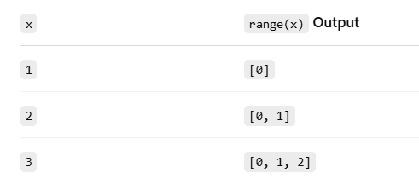
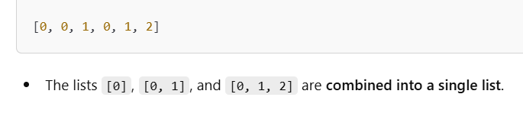
flatMap
range(x) generates a sequence from 0 to x-1 for each element in the RDD.
flatMap() flattens these sequences into a single list.
Breakdown of range(x) for each value:
Final Output

Slide 37
Basic Actions
nums = sc.parallelize([1, 2, 3])
# Retrieve RDD contents as a local collection
nums.collect() # => [1, 2, 3]
# Return first K elements
nums.take(2) # => [1, 2]
# Count number of elements
nums.count() # => 3
# Merge elements with an associative function
nums.reduce(lambda x, y: x + y) # => 6
# Write elements to a text file
nums.saveAsTextFile(“hdfs://file.txt”)
Notes:
Launch computations

Slide 38
Reduce function
nums = sc.parallelize([1, 2, 3]) creates an RDD containing [1, 2, 3].
Applying reduce(lambda x, y: x + y):
The function takes two elements at a time and applies the + operation.
The process follows a tree-like aggregation, reducing elements step by step.
Iteration 1:
Takes first two elements: 1 + 2 = 3
Iteration 2:
Takes result 3 and adds the next element: 3 + 3 = 6

Slide 39
Working with Key-Value Pairs
Spark’s “distributed reduce” transformations operate on RDDs of key-value pairs
Python: pair = (a, b) pair[0] # => a pair[1] # => b
Scala: val pair = (a, b) pair._1 // => a pair._2 // => b
Java: Tuple2 pair = new Tuple2(a, b); pair._1 // => a pair._2 // => b

Slide 40
Some Key-Value Operations
pets = sc.parallelize( [(“cat”, 1), (“dog”, 1), (“cat”, 2)])
pets.reduceByKey(lambda x, y: x + y) # => {(cat, 3), (dog, 1)}
pets.groupByKey() # => {(cat, [1, 2]), (dog, [1])}
pets.sortByKey() # => {(cat, 1), (cat, 2), (dog, 1)}
reduceByKey also automatically implements combiners on the map side

Slide 41
Example: Word Count
lines = sc.textFile(“hamlet.txt”)
counts = lines.flatMap(lambda line: line.split(“ ”)) .map(lambda word => (word, 1)) .reduceByKey(lambda x, y: x + y)
“to” “be” “or”
(to, 1) (be, 1) (or, 1)
(be, 2) (not, 1)
“to be or”
“not” “to” “be”
(not, 1) (to, 1) (be, 1)
“not to be”
(or, 1)
(to, 2)
Notes:
Output of lines.flatMap(lambda line: line.split(“ ”)) : ["to", "be", "or", "not", "to", "be"]
Output of map(lambda word: (word, 1)) : [("to", 1), ("be", 1), ("or", 1), ("not", 1), ("to", 1), ("be", 1)]
Output of reduceByKey(lambda x, y: x + y) : [("to", 2), ("be", 2), ("or", 1), ("not", 1)]

Slide 42
Other Key-Value Operations
visits = sc.parallelize([ (“index.html”, “1.2.3.4”), (“about.html”, “3.4.5.6”), (“index.html”, “1.3.3.1”) ])
pageNames = sc.parallelize([ (“index.html”, “Home”), (“about.html”, “About”) ])
visits.join(pageNames) # (“index.html”, (“1.2.3.4”, “Home”)) # (“index.html”, (“1.3.3.1”, “Home”)) # (“about.html”, (“3.4.5.6”, “About”))
visits.cogroup(pageNames) # (“index.html”, ([“1.2.3.4”, “1.3.3.1”], [“Home”])) # (“about.html”, ([“3.4.5.6”], [“About”]))

Slide 43
Setting the Level of Parallelism
All the pair RDD operations take an optional second parameter for number of tasks
words.reduceByKey(lambda x, y: x + y, 5)
words.groupByKey(5)
visits.join(pageViews, 5)

Slide 44
Using Local Variables
Any external variables you use in a closure will automatically be shipped to the cluster:
query = sys.stdin.readline()
pages.filter(lambda x: query in x).count()
Some caveats:
Each task gets a new copy (updates aren’t sent back)
Variable must be Serializable / Pickle-able
Don’t use fields of an outer object (ships all of it!)

Slide 45
Under The Hood: DAG Scheduler
General task graphs
Automatically pipelines functions
Data locality aware
Partitioning aware to avoid shuffles
B:
A:
F:
Stage 1
groupBy
C:
D:
E:
join
Stage 2
map
filter
Stage 3
= RDD
= cached partition
Notes:
NOT a modified version of Hadoop

Slide 46
More RDD Operators
map
filter
groupBy
sort
union
join
leftOuterJoin
rightOuterJoin
reduce
count
fold
reduceByKey
groupByKey
cogroup
cross
zip
sample
take
first
partitionBy
mapWith
pipe
save ...

Slide 47
How to Run Spark

Slide 48
Language Support
Python
lines = sc.textFile(...) lines.filter(lambda s: “ERROR” in s).count()
Standalone Programs
Python, Scala, & Java
Interactive Shells
Python & Scala
Performance
Java & Scala are faster due to static typing
…but Python is often fine
Scala
val lines = sc.textFile(...) lines.filter(x => x.contains(“ERROR”)).count()
Java
JavaRDD<String> lines = sc.textFile(...); lines.filter(new Function<String, Boolean>() { Boolean call(String s) { return s.contains(“error”); } }).count();

Slide 49
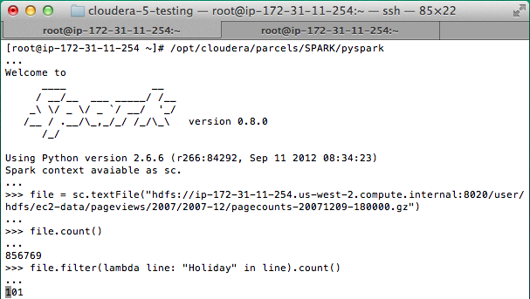
Interactive Shell
The Fastest Way to Learn Spark
Available in Python and Scala
Runs as an application on an existing Spark Cluster…
OR Can run locally
Notes:
The barrier to entry for working with the spark API is minimal

Slide 50
… or a Standalone Application
import sys
from pyspark import SparkContext
if __name__ == "__main__":
sc = SparkContext( “local”, “WordCount”, sys.argv[0], None) lines = sc.textFile(sys.argv[1])
counts = lines.flatMap(lambda s: s.split(“ ”)) \ .map(lambda word: (word, 1)) \ .reduceByKey(lambda x, y: x + y) counts.saveAsTextFile(sys.argv[2])

Slide 51
Create a SparkContext
import org.apache.spark.SparkContext
import org.apache.spark.SparkContext._
val sc = new SparkContext(“url”, “name”, “sparkHome”, Seq(“app.jar”))
Scala
Cluster URL, or local / local[N]
App name
Spark install path on cluster
List of JARs with app code (to ship)
import org.apache.spark.api.java.JavaSparkContext;
JavaSparkContext sc = new JavaSparkContext(
“masterUrl”, “name”, “sparkHome”, new String[] {“app.jar”}));
Java
Python
from pyspark import SparkContext
sc = SparkContext(“masterUrl”, “name”, “sparkHome”, [“library.py”]))
Notes:
Mention assembly JAR in Maven etc
Use the shell with your own JAR`

Slide 52
Add Spark to Your Project
Scala / Java: add a Maven dependency on
groupId: org.spark-project artifactId: spark-core_2.10 version: 0.9.0
Python: run program with our pyspark script

Slide 53
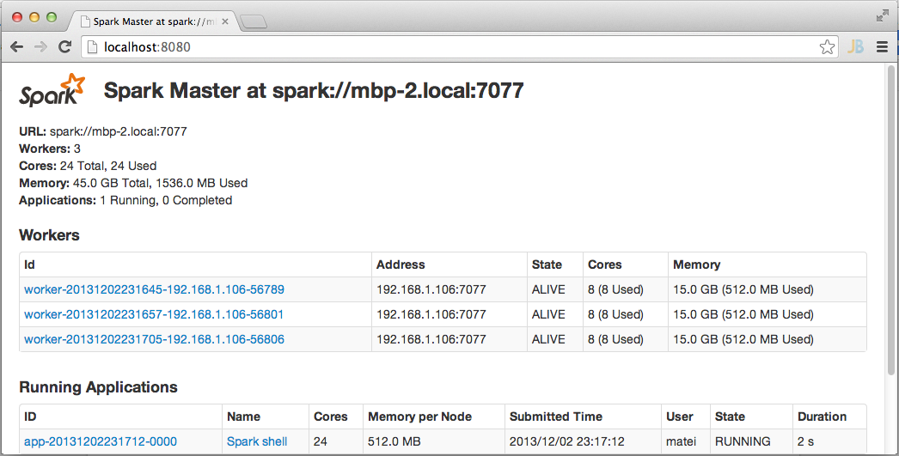
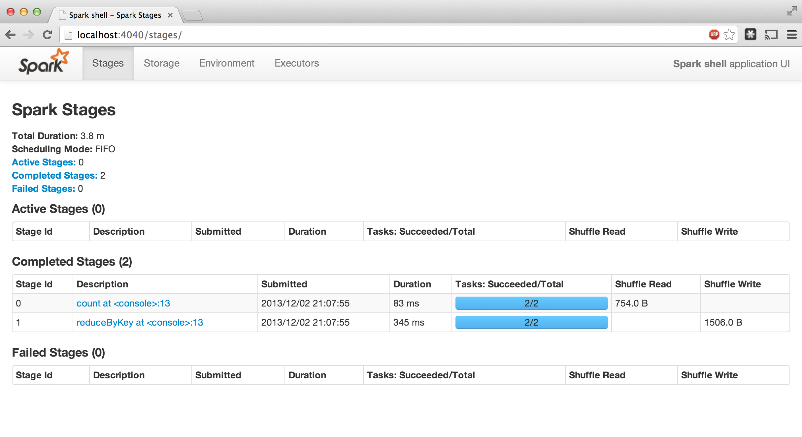
Administrative GUIs
http://<Standalone Master>:8080 (by default)

Slide 54
Software Components
Spark runs as a library in your program (1 instance per app)
Runs tasks locally or on cluster
Mesos, YARN or standalone mode
Accesses storage systems via Hadoop InputFormat API
Can use HBase, HDFS, S3, …
Your application
SparkContext
Cluster manager
Local threads
Worker
Worker
Spark executor
Spark executor
HDFS or other storage

Slide 55
Local Execution
Just pass local or local[k] as master URL
Debug using local debuggers
For Java / Scala, just run your program in a debugger
For Python, use an attachable debugger (e.g. PyDev)
Great for development & unit tests

Slide 56
Cluster Execution
Easiest way to launch is EC2: ./spark-ec2 -k keypair –i id_rsa.pem –s slaves \ [launch|stop|start|destroy] clusterName
Several options for private clusters:
Standalone mode (similar to Hadoop’s deploy scripts)
Mesos
Hadoop YARN
Amazon EMR: tinyurl.com/spark-emr

Slide 57
Example Application: PageRank
Notes:
To Skip to the next section, go to slide 51

Slide 58
Example: PageRank
Good example of a more complex algorithm
Multiple stages of map & reduce
Benefits from Spark’s in-memory caching
Multiple iterations over the same data

Slide 59
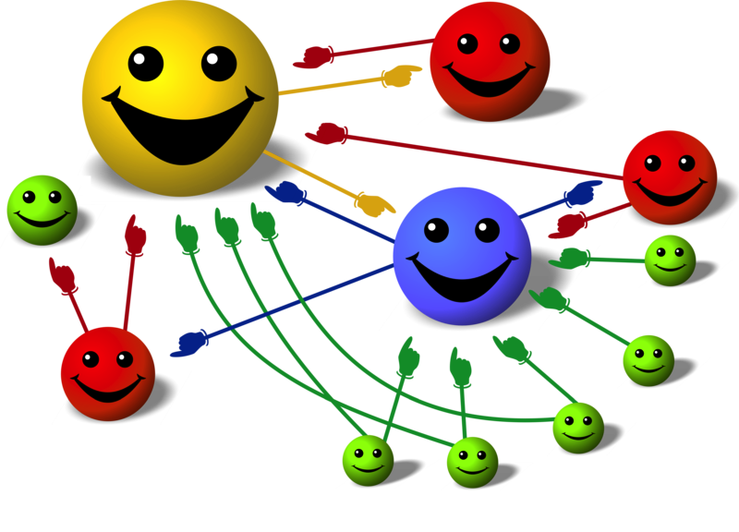
Basic Idea
Give pages ranks (scores) based on links to them
Links from many pages ➔ high rank
Link from a high-rank page ➔ high rank
Image: en.wikipedia.org/wiki/File:PageRank-hi-res-2.png

Slide 60
Algorithm
Start each page at a rank of 1
On each iteration, have page p contribute rank_{p} / |neighbors_{p}| to its neighbors
Set each page’s rank to 0.15 + 0.85 × contribs
1.0
1.0
1.0
1.0

Slide 61
Algorithm
Start each page at a rank of 1
On each iteration, have page p contribute rank_{p} / |neighbors_{p}| to its neighbors
Set each page’s rank to 0.15 + 0.85 × contribs
1.0
1
0.5
1
1.0
0.5
1.0
0.5
0.5
1.0

Slide 62
Algorithm
Start each page at a rank of 1
On each iteration, have page p contribute rank_{p} / |neighbors_{p}| to its neighbors
Set each page’s rank to 0.15 + 0.85 × contribs
1.85
0.58
1.0
0.58

Slide 63
Algorithm
Start each page at a rank of 1
On each iteration, have page p contribute rank_{p} / |neighbors_{p}| to its neighbors
Set each page’s rank to 0.15 + 0.85 × contribs
1.85
0.58
0.5
1.85
0.58
0.29
1.0
0.29
0.5
0.58

Slide 64
Algorithm
Start each page at a rank of 1
On each iteration, have page p contribute rank_{p} / |neighbors_{p}| to its neighbors
Set each page’s rank to 0.15 + 0.85 × contribs
1.31
0.39
. . .
1.72
0.58

Slide 65
Algorithm
Start each page at a rank of 1
On each iteration, have page p contribute rank_{p} / |neighbors_{p}| to its neighbors
Set each page’s rank to 0.15 + 0.85 × contribs
Final state:
1.44
0.46
1.37
0.73

Slide 66
Scala Implementation
val links = // load RDD of (url, neighbors) pairs
var ranks = // load RDD of (url, rank) pairs
for (i <- 1 to ITERATIONS) {
val contribs = links.join(ranks).flatMap {
case (url, (links, rank)) =>
links.map(dest => (dest, rank/links.size))
} ranks = contribs.reduceByKey(_ + _) .mapValues(0.15 + 0.85 * _)
} ranks.saveAsTextFile(...)

Slide 67
PageRank Performance
Notes:
54 GB Wikipedia dataset

Slide 68
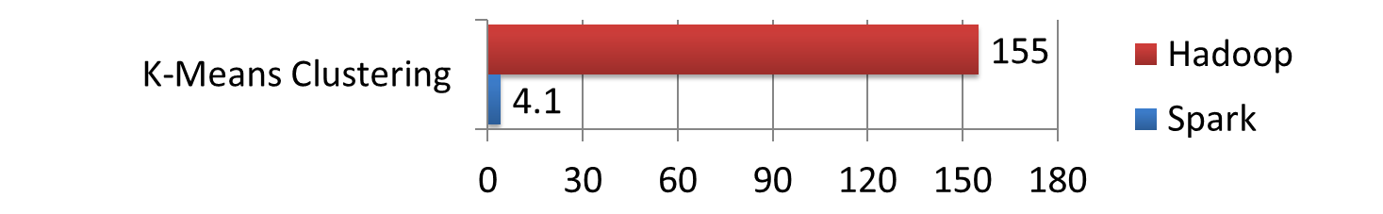
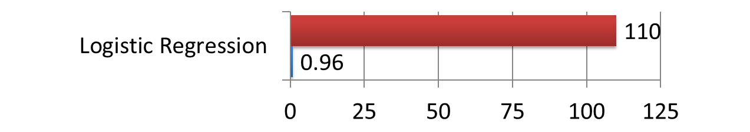
Other Iterative Algorithms
Time per Iteration (s)
Notes:
100 GB datasets

Slide 69
Conclusion
Spark offers a rich API to make data analytics fast: both fast to write and fast to run
Achieves 100x speedups in real applications
Growing community with 25+ companies contributing

Slide 70
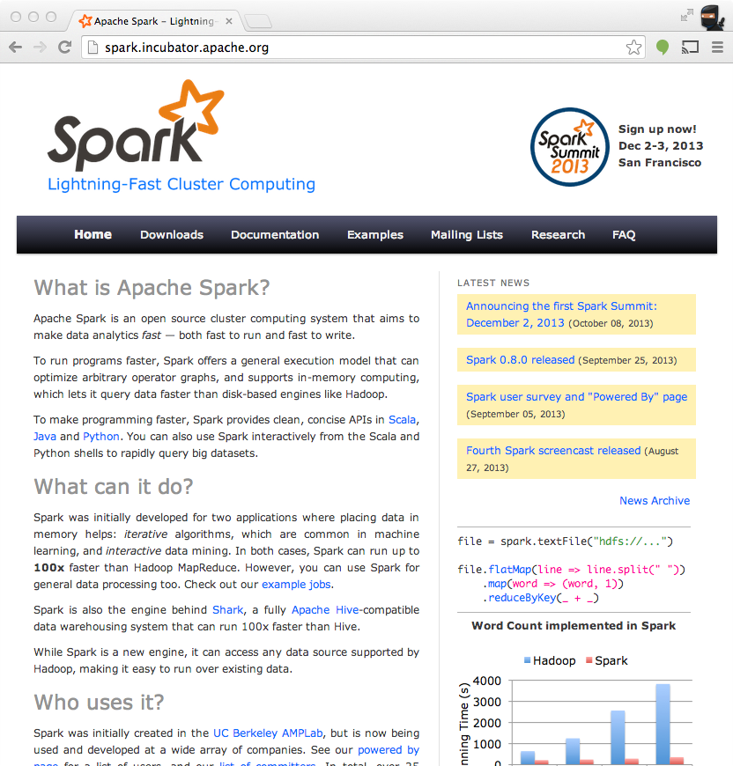
Get Started
Up and Running in a Few Steps
Download
Unzip
Shell
Project Resources
Examples on the Project Site
Examples in the Distribution
Documentation
http://spark.incubator.apache.org

